Slide 1
CSC 4780 – DNS and Security
Susmit Shannigrahi

Slide 2
DNS Overview
System on the Internet that maps names to numbers/IP addresses
A directory service
Google/ChatGPT but more definite
Think Telephone directory but numbers change very frequently
Almost everything depends on the Internet returning the right number for the right request
Break the DNS, break the Internet

Slide 3
History
Before DNS, all mappings were in hosts.txt
/etc/hosts on Linux
C:\Windows\System32\drivers\etc\hosts on Windows
Centralized, manual system
Changes were submitted to SRI via email
Machines periodically FTP new copies of hosts.txt
Administrators could pick names at their discretion
Any name was allowed
This_is_my_funny_name_on_the_web

Slide 4
History – Hosts.txt
Eventually, the hosts.txt system fell apart
Not scalable, SRI couldn’t handle the load
Hard to enforce uniqueness of names
e.g TTU
Tennessee Tech ot
Texas Tech
Many machines had inaccurate copies of hosts.txt
Thus, DNS was born

Slide 5
Naming Hierarchy
Root
net
edu
com
gov
mil
org
uk
fr
etc.
Top Level Domains (TLDs) are at the top
Maximum tree depth: 128
Each Domain Name is a subtree
.edu → tntech.edu → cs.tntech.edu → www.cs.tntech.edu
Name collisions are avoided
tntech
mit
cs
ece
husky
www
login
mail

Slide 6
Hierarchical Administration
Verisign
Root
ICANN
net
edu
com
gov
mil
org
uk
fr
etc.
Tree is divided into zones
Each zone has an administrator
Responsible for the part of the heirarchy
Example:
CCIS controls *.ccs.neu.edu
NEU controls *.neu.edu
tntech
mit
cs
www
login
mail

Slide 7
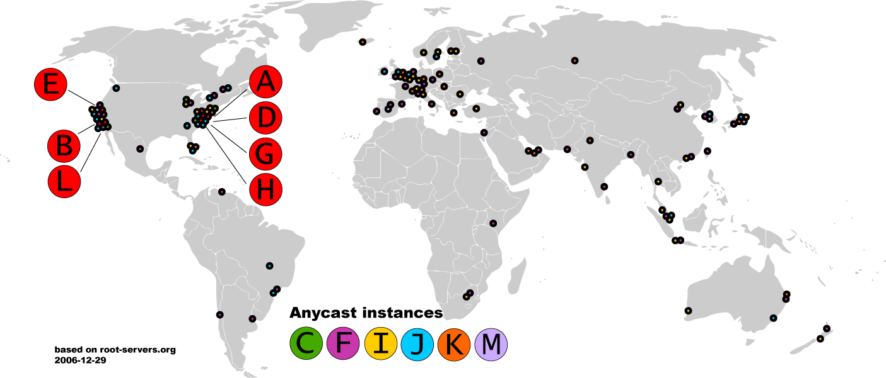
Map of the Roots - 2006

Slide 8
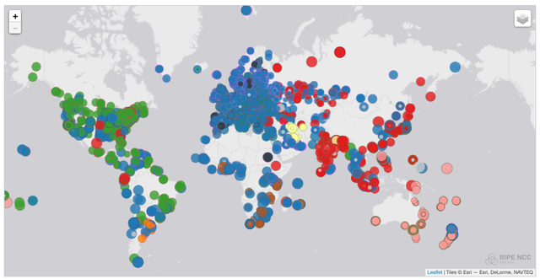
Map of the K Roots - 2017

Slide 9
DNS Resolving
When host makes DNS query, query is sent to its local DNS server.
acts as proxy, forwards query into hierarchy.
Two resolving schemes:
Iterative, and
Recursive.

Slide 10
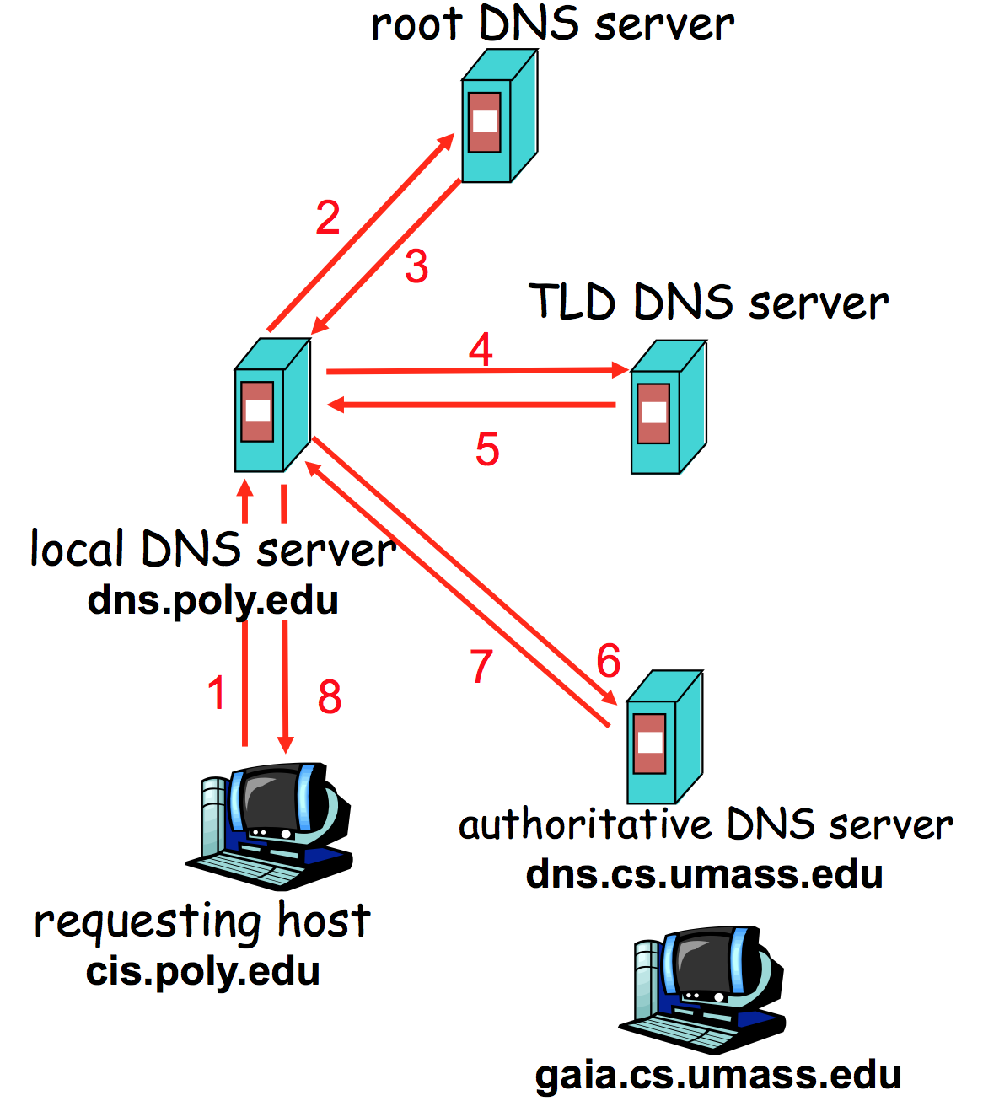
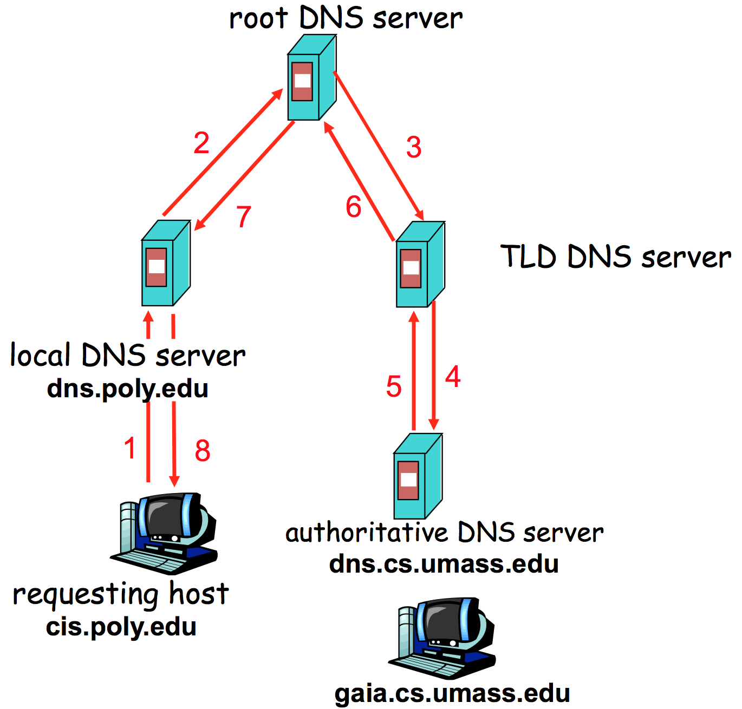
DNS Resolving - 2

Slide 11
DNS is Distributed
Three possible answers to any question
Here’s your number
Go away
I don’t know, ask that guy over there <- Delegate
Go ask the other guy a lot of work!
Infrastructure divided into Servers (that run around) and Clients, or Stub Resolvers, that either do or don’t get an answer
BIND = Name Server
Your Laptop = Stub Resolver

Slide 12
Caching
DNS responses are cached
Quick response for repeated translations
Negative results are also cached
Save time for nonexistent sites, e.g. misspelling
Cached data periodically times out
Each record has a TTL field

Slide 13
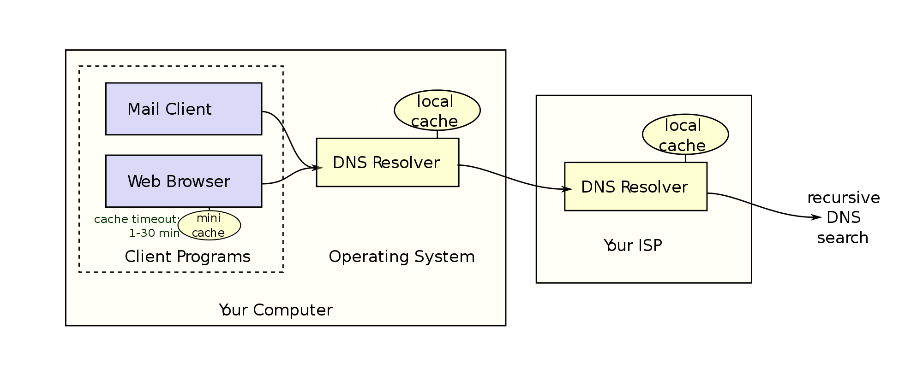
Caching - 2

Slide 14
Inherent DNS Vulnerabilities
Users/hosts typically trust the host-address mapping provided by DNS
What bad things can happen with wrong DNS info?
DNS resolvers trust responses received after sending out queries.
How to attack?
Obvious problem
No authentication for DNS responses
Notes:
Automatic software updates often relies on DNS.
Mail Servers.

Slide 15
Bad Guys and the guessing game
You are converting names to numbers. As a bad guy, don’t you want to return number quickly?
Yes!
What prevents this?
Transaction ID – 23654 (16 bit number)
Include this in your request
Bad actor doesn’t know this, so can’t reply with the correct number
But the bad server can guess
Transaction ID between 1-65K
When the good server wins, they set a TTL or Time to Live
This is how long that reply is valid
So Short or Long TTL?

Slide 16
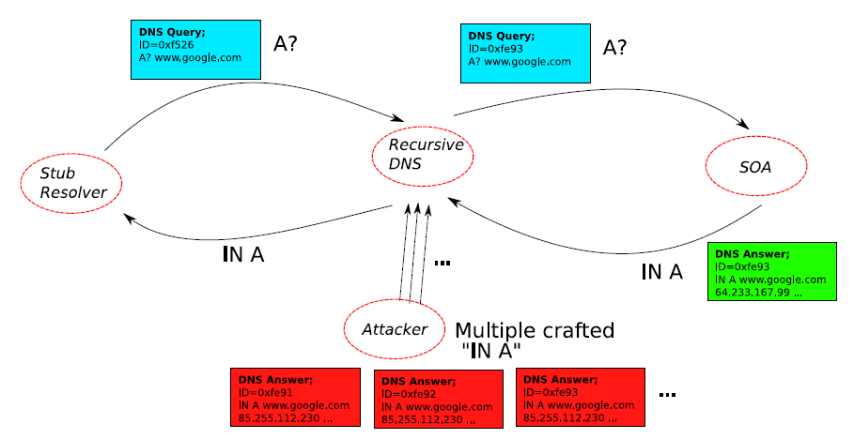
DNS cache poisoning: Racing to Respond First
Notes:
After the recursive DNS sends a query to SOA (Start Of Authority), the attacker responds first.

Slide 17
Long TTL – Maybe?
When it’s a race, the bad server has the advantage
Real requests take time to reply
Fake replies are faster – can be premade
Who says you can only reply once?
Bad servers can reply 100 times
Advantage goes from 65K to 1 to 655 to 1
So once you win, you keep winning
So if the good server wins, it makes sense to keep the TTL large
No?
Wait until slide 23

Slide 18
DNS Rake
Enter The DNSRake
Named after a common method for lockpicking
User is asking for foo.com
Local resolver sends a query to a nameserver, for $RANDOM.foo.com
The bad guy has the starter pistol
Send 200 fake replies to that nameserver, with TXID
The bad guy can reply multiple times
Send replies containing nameserver redirections to
www.foo.com IN A 6.6.6.6
If it fails, return to step 1, try again
Reply is cached until TTL

Slide 19
Defense Using The Bailiwicks Rules
The bailiwick system prevents foo.com from declaring anything about “com”, or some other new TLD, or www.google.com
Using the bailiwicks rules
The root servers can return any record
The com servers can return any record for com
The google.com servers can return any record for google.com

Slide 20
DNS cache poisoning – Birthday attack
Improve the chance of responding before the real nameserver (discovered by Vagner Sacramento in 2002)
Have many (say hundreds of) clients send the same DNS request to the name server
Each generates a query
Send hundreds of reply with random transaction IDs at the same time
Due to the Birthday Paradox, the success probability can be close to 1
300 will give you 50%.
700 will give you 1.07%

Slide 21
DNS cache poisoning – Kaminsky, 2008
Kaminsky Attack
Big security news in summer of 2008
DNS servers worldwide were quickly patched to defend against the attack
In previous attacks, when the attacker loses the race, the record is cached, with a TTL.
Before TTL expires, no attack can be carried out
Poisoning address for google.com in a DNS server is not easy.

Slide 22
What is New in the Kaminsky Attack?
The bad guy does not need to wait to try again
The bad guy asks the resolver to look up www.google.com
If the bad guy lost the race, the other race for www.google.com will be suppressed by the TTL
If the bad guy asks the resolver to look up 1.google.com, 2.google.com, 3.google.com, and so on
Each new query starts a new race
Eventually, the bad guy will win
he is able to spoof 183.google.com
So what? No one wants to visit 183.google.com

Slide 23
Kaminsky-Style Poisoning
A bad guy who wins the race for “183.google.com” can end up stealing “www.google.com” as well
Original malicious response:
google.com NS www.google.com
www.google.com A 6.6.6.6
Killer response:
google.com NS ns.badguy.com

Slide 24
Kaminsky-Style Poisoning (cont’)
Why it succeeded:
Can start anytime; no waiting for old good cached entries to expire
No “wait penalty” for racing failure
The attack is only bandwidth limited
Defense
Also randomize the UDP used to send the DNS query, the attacker has to guess that port correctly as well (increase the space of possible IDs).

Slide 25
So what do we do?
Difficulty to change the protocol
Protocol stability (embedded devices)
Backward compatibility.
Long-term
Cryptographic protections
E.g., DNSSEC, DNSCurve
Require changes to both recursive and authority servers
A multi-year process
Short-term
Only change the recursive server (local DNS).
Easy to adopt

Slide 26
Short-Term Defenses
Source port randomization
Add up to 16 bits of entropy
NAT could de-randomize the port
DNS 0x20 encoding
From Georgia tech, CCS 2008
Tighter logic for accepting responses

Slide 27
DNS-0x20 Bit Encoding
DNS labels are case insensitive
Matching and resolution is entirely case insensitive
A resolver can query in any case pattern
E.g., WwW.ExAmpLe.cOM
It will get the answer for www.example.com

Slide 28
DNS-0x20 DNS Encoding (cont’)
The mixed pattern of upper and lower case letters constitutes a channel, which can be used to improve DNS security
Only the real server knows the correct pattern
A DNS response contains the query being asked
When generating the response, the query is copied from the request exactly into the response
The case pattern of the query is preserved in the response
Open source implementations exhibit this behavior
The DNS request is rewritten in place

Slide 29
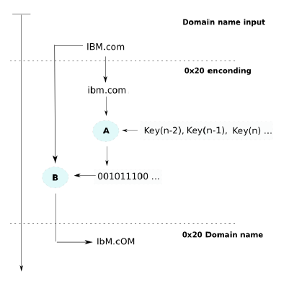
Query Encoding
Transforms the query into all lowercase
Encrypt the query with a key shared by all queries on the recursive server (A)
The cipher text is used to encode the query
0: buff[i] |= 0x20 (upper)
1: buff[i] &= 0x20 (lower)
Notes:
A 0x41 while a is 0x61

Slide 30
DNS-0x20 Encoding Analysis
Do existing authority servers preserve the case pattern?
Yes

Slide 31
Other DNS attacks
Attacking home routers/gateways
Incidence in Mexico in 2008
an email sent to users
email include URL (HTTP requests) to the HTTP-based interface of wireless routers
using the default password to reconfigure the router/gateway

Slide 32
Long Term Solution
DNSSEC:
Authenticate responses.
Google DNS now is enabled by default.
Challenges in deployment:
Response is large, might no linger fit in single UDP message.
Legacy software and machines.
Not without problems and controversy

Slide 33
Takeaway
Security problems can be really nuanced
More security isn’t better - deep understanding and logical thinking is.
Availability is more important than security

Slide 34
Reading List
It’s the end of the cache as we know it
https://blackhat.com/presentations/bh-jp-08/bh-jp-08-Kaminsky/BlackHat-Japan-08-Kaminsky-DNS08-BlackOps.pdf
An Illustrated Guide to the Kaminsky DNS Vulnerability
http://unixwiz.net/techtips/iguide-kaminsky-dns-vuln.html

